Slide 1

Python Review and Tutorial

Slide 2

Intent of Class
Quick review of Python
Problem-centric
Tailor to needs
Please give feedback on what you would like out of the course
Please give suggestions on other topics to cover
Other languages, specific problems, automation, etc

Slide 3
Overview
Review of Basics
Extending Python
The Pythonic Way
Pandas Data Wrangling
PyODBC Data Base Connector
MatPlotLib Visuals
Scikit-Learn Machine Learning
Automating Python Scripts in Windows
Putting It All Together

Slide 4
Review of Basics
Environments
Basic Properties
Variables
Comments
Collections
Conditionals
Loops
Functions

Slide 5

Environments
Problem
You are given a new project in which you need to get updates on parts that are arriving at your facility. Continually checking for the parts to arrive will waste time, so an automated approach will be beneficial.

Slide 6
Environments
Problem:
How can we offload this workload?
What do we need to set it up?

Slide 7
Environments
How can we offload this workload?
Can’t constantly check for parts to arrive in database.
Can automate a program to check as often as needed.
Perhaps Python can help us …

Slide 8
Environments
What do we need to set it up?
Need application to convert code to machine language
All-in-one packages:
Integrated Development Environments (IDE)
Integrated Scripting Environments (ISE)
Link translation program and debugger, at a minimum

Slide 9
Review of Basics
Environments
IDLE
Included with Python, written in Python
Integrated Development and Learning Environment
https://www.python.org/downloads/

Slide 10
Review of Basics
Environments
Anaconda
Spyder GUI
Iron Python console
IDLE console
Includes many packages
https://www.anaconda.com/distribution/#download-section

Slide 11
Review of Basics
Environments
Others
Plugins for Visual Studio
PyCharm
Jupyter
Server based – can run online
Coursera runs this

Slide 12
Review of Basics
Problem
I have one of these new fangled IDE’s, but I have no idea how to use it.
How do I use the IDE?

Slide 13
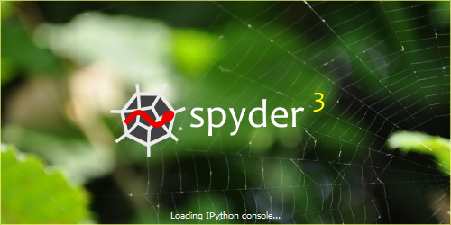
Review of Basics
How do I use the IDE?
In this course, I will be using the Spyder IDE found in the Anaconda package

Slide 14
Review of Basics
How do I use the IDE?
Feel free to use an IDE that you are comfortable with. See previous slides for other IDE ideas.

Slide 15
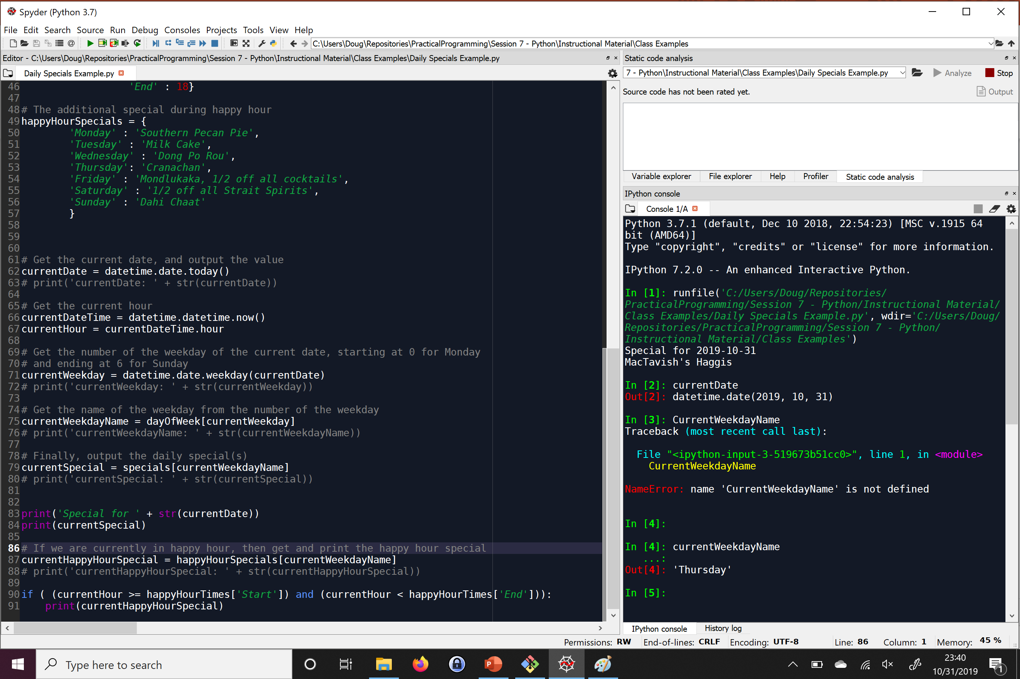
Review of Basics
Script Window – Write entire programs here
Spyder

Slide 16
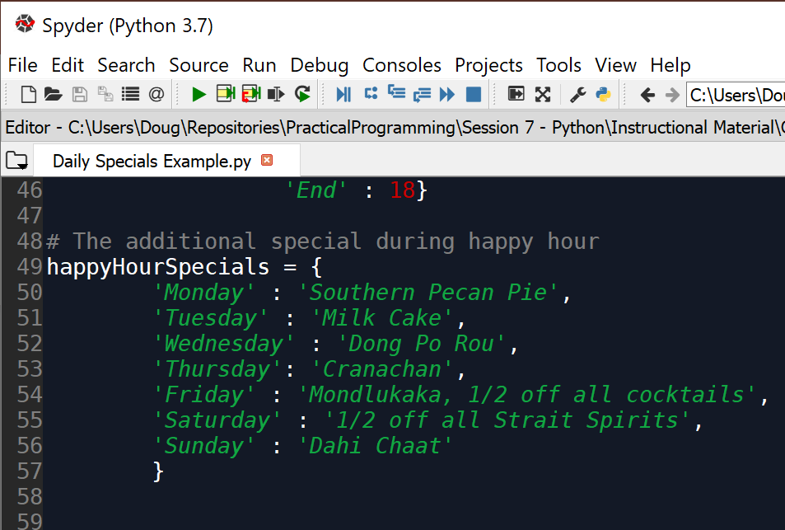
Review of Basics
Run Button - Press this button to run completed scripts
Spyder

Slide 17
Review of Basics
Terminal – Write real-time code here, and see code execution outputs here
Spyder

Slide 18
Basic Properties
Basic Properties of Python
Problem:
I need to get up and running quickly, as well as be able to write programs quickly without understanding a lot of computer science.
I still want control over my programs and how they run, not just to tell the program what data to get.
Will Python support these needs?
Notes:
Things to keep in the back of your mind for now.
Will help more when we get into other programming languages, like SQL

Slide 19
Basic Properties
Basic Properties of Python
Compiled or Interpreted: Interpreted
Can also be compiled
Can better check data in real time
Typing discipline:
Duck-typed
Dynamic
Easier to switch data types on-the-fly
Declarative or Imperative: Imperative Language
Allows us to tell the program how do to what we need it to do
Notes:
Things to keep in the back of your mind for now.
Will help more when we get into other programming languages, like SQL

Slide 20
Primitive Variables
Primitive Variables
I need a way to store data in my program without having to analyze memory in the computer.
I need a way to be able to change data that is stored.
I need to be able to store different types of data in a way that will minimize data comprehension errors by the computer.
I also need a way for the computer to be able to tell me when I am doing something with a type of data that I should not be doing.
Notes:
Called float because it is a floating point. Example: output x=32984328947213.21934782391472193874239847293184

Slide 21
Primitive Variables
Problems
How can I get around the tedious and complex process of managing memory for my application?
How can I change the data stored in my program?
What will prevent Python from performing incorrect operations on different types of data?
Notes:
Called float because it is a floating point. Example: output x=32984328947213.21934782391472193874239847293184

Slide 22
Primitive Variables
How can I get around the tedious and complex process of managing memory for my application?
How can I change the data stored in my program?
Variables
X=5
Employee=‘Jesse’
Notes:
Called float because it is a floating point. Example: output x=32984328947213.21934782391472193874239847293184

Slide 23
Primitive Variables
In-class exercise:
Create a variable that holds a customer name
Rewrite the value in the variable
Notes:
Called float because it is a floating point. Example: output x=32984328947213.21934782391472193874239847293184

Slide 24
Review of Basics
Primitive Variables
What will prevent Python from performing incorrect operations on different types of data?
Datatypes
Notes:
Called float because it is a floating point. Example: output x=32984328947213.21934782391472193874239847293184

Slide 25
Review of Basics
Primitive Variables
Integers
Whole numbers
Exact values
Int_val = 5
Notes:
Called float because it is a floating point. Example: output x=32984328947213.21934782391472193874239847293184

Slide 26
Review of Basics
Primitive Variables
Float
Decimal values
Approximate values
Float_val = 2.5
Notes:
Called float because it is a floating point. Example: output x=32984328947213.21934782391472193874239847293184

Slide 27
Review of Basics
Primitive Variables
Strings
Characters, text storage, and limited markup storage
String_val = “this is a string, friend”
string_val = ‘this is also a string, friend’
Notes:
Called float because it is a floating point. Example: output x=32984328947213.21934782391472193874239847293184

Slide 28
Review of Basics
Primitive Variables
Booleans
Yes or no values
True or false values
bool_true_val = True
bool_false_val = False
Notes:
Called float because it is a floating point. Example: output x=32984328947213.21934782391472193874239847293184

Slide 29
Review of Basics
Primitive Variables
Datatype tells what operations are permissible
‘+’ Operator adds numeric data types
‘+’ Operator concatenates strings
In-class exercise:
Add two numbers together
Concatenate two strings together
Add a number and a string together
Notes:
Called float because it is a floating point. Example: output x=32984328947213.21934782391472193874239847293184

Slide 30
Review of Basics
Variables
Problem:
When I try and add a string that is definitely a number to a number, I still get an error. The string is ‘5’, so I know it should be a number, but Python doesn’t understand this
How can I check what a variable’s current data type is?
How can I get Python to understand a certain datatype should actually be something else?
Notes:
Variables store values. Variables let us not worry about memory management. Variables can change.

Slide 31
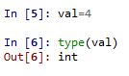
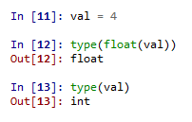
Review of Basics
Variables
Getting the type
type() function
Conversions
type name, followed by value to convert in parenthesis
float(int_val)
str(double_val)
Notes:
Variables store values. Variables let us not worry about memory management. Variables can change.

Slide 32
Review of Basics
Variables
In-class exercise:
Give the following variables:
Make sure you know what the datatypes are
Mathematically add them
current_engine_hours = 147
next_reported_hours = ‘3’
Notes:
Variables store values. Variables let us not worry about memory management. Variables can change.

Slide 33

Review of Basics
Review
Integrated Development Environments
Variables
Datatypes
Conversions
Notes:
Variables store values. Variables let us not worry about memory management. Variables can change.

Slide 34
Review of Basics
Comments
Problem:
I understand what code I have written, but I am not sure I will understand later. I am also not sure if my teammates will understand what the code is doing if they need to work on the same code.
How can I explain or annotate my code without the computer thinking I am giving it commands?

Slide 35
Review of Basics
Comments
#
Single-line comment
“”” “”” or ‘’’ ‘’’
Designed for documentation sections
Can work as a block-style comment for testing

Slide 36
Review of Basics
Collections
Problem:
Single values in variables in usually useful, but sometimes I need to represent multiple values of data that belong to the same thing, such as the day names in a week, without wanting to create a separate variable for each value.
How can I store multiple values in one variable?

Slide 37
Review of Basics
Collections
How can I store multiple values in one variable?
Tuple
List

Slide 38
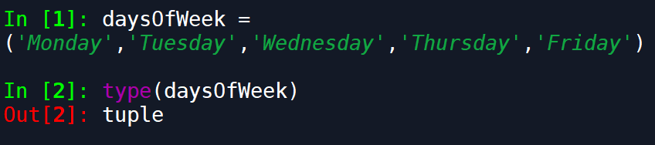
Review of Basics
Collections
tuple
Tuple is mathematical set of numbers
Set and access elements with ()
Analogous to array, value-type collection
Can mix value data types

Slide 39
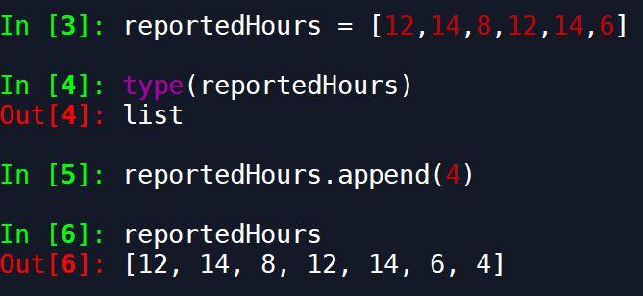
Review of Basics
Collections
list
Holds multiple values that can change
Set and access elements with []
Reference-type collection
Can mix value data types

Slide 40
Review of Basics
Collections
Problem:
The datatypes that house multiple values are nice, but I would like a way to still give a name for my data. For instance, maybe I want to keep track of all of my funds across multiple accounts, or perhaps I want to store my restaurant’s specials for each day of the week.
How can I create a key-value pair of data that is stored in a single datatype?

Slide 41
Review of Basics
Collections
How can I create a key-value pair of data that is stored in a single datatype?
dictionary

Slide 42
Review of Basics
Collections
dictionary
Hash table, name:value pair
Set with {}
Access elements with []
Very fast at loading values
Further reading: https://stackoverflow.com/questions/327311/how-are-pythons-built-in-dictionaries-implemented

Slide 43
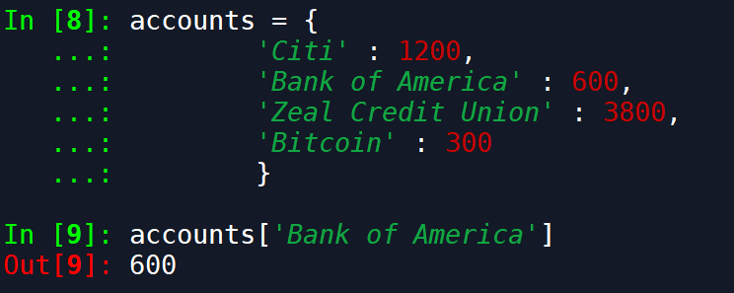
Review of Basics
Collections
dictionary

Slide 44
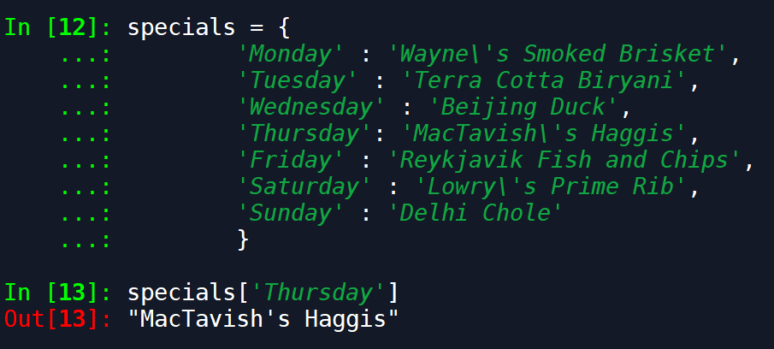
Review of Basics
Collections
dictionary

Slide 45

Review of Basics
Class Exercise:
Create a list of at least 5 foods
Create a tuple/an array of constant values (like days in the year, approximate value of pi, etc)
Create a dictionary of state abbreviations and names
Create a list of dictionaries

Slide 46
Review of Basics
Conditionals
Problem:
I have a happy hour for my restaurant with an a second special in addition to the daily special. I need my computer to be able to decide which day it is, if it is happy hour, and what specials to display.
How do I get the computer to make decisions?

Slide 47
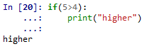
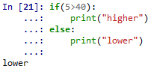
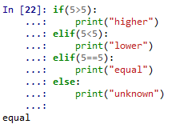
Review of Basics
Conditionals
if
if-else
if-elif
if-elif-else
switch
Not implemented, must use dictionaries in a function
Why did we do this?

Slide 48
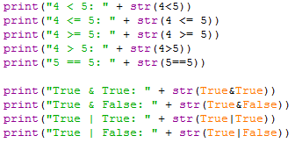
Review of Basics
Conditionals
Logical operators examples
Notes:
Data types must match for equality to return true

Slide 49
Review of Basics
Conditionals Class Example
Example code ‘Daily Specials Example.py’

Slide 50
Review of Basics
Conditionals Class Exercise
Write code to compare two variables:
One containing an integer number
One variable containing a string number
For instance, ’10’ > 5 should be True.

Slide 51
Review of Basics
Review
Collections
Tuple/Array
List
Dictionary
Conditionals
Used to make decisions/comparisons
Additional conditionals in ./Instructional Material/Class Examples/ConditionalStatements.py

Slide 52
Review of Basics
Loops
Problem:
I have written some code, but now I need to apply it to a large number of values in a list.
I need to find if a specific condition exists, but I do not know how many values I need to check
How can I apply the same section of code to a large number of values without rewriting the code?
How can I iterate over values checking a condition when I don’t know how many values I need to check?

Slide 53
Review of Basics
Loops
How can I apply the same section of code to a large number of values without rewriting the code?
for loop
Loops through each element in a collection
Use range() to get a quick list of elements

Slide 54
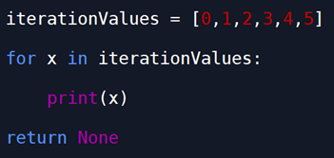
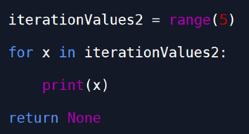
Review of Basics
Loops

Slide 55
Review of Basics
Loops
How can I iterate over values checking a condition when I don’t know how many values I need to check?
while loop
See next slide

Slide 56
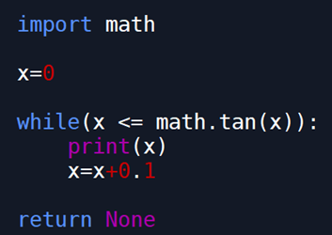
Review of Basics

Slide 57
Review of Basics
Loops
Loop examples:
./Instructional Material/Class Examples/Loop Examples.py

Slide 58
Review of Basics
Loops
In-class exercises:
Create a list of the days of the week, and print each day using a loop
Create a loop that counts from 0 -100, and prints all even numbers

Slide 59
Review of Basics
Loops
Real-world example:
Waiting for a part to show up in stores
./Instructional Material/Class Examples/Real World Loop Example/Listener.py

Slide 60
Review of Basics
Loops
Real-world example problem:
I have been given a list of project profits, and I need to check if any of them are below zero.

Slide 61
Review of Basics
Loops
Real-world example problem:
I have the times of my employees, and I need to check if they have worked overtime this week or not.

Slide 62
Review of Basics
Loops
Real-world example problem:
I have a set of parts in the repair process with the need-by times and average repair times. I need to check if any of them are over-due, or are projected to not be repaired in time.

Slide 63
Review of Basics
Datetime Library Side Notes
Library allows working with dates, times, and datetimes
Introduces datetime datatype-combination of date and time
Introduces date datatype, which consists of just dates
Conversions between date, datetime and other datatypes
Arithmetic manipulation of datetimes

Slide 64
Review of Basics
Datetime Library Side Notes
Tokens for specifying strings in string to datetime conversions:
https://docs.python.org/3/library/datetime.html#strftime-strptime-behavior

Slide 65
Review of Basics
Datetime Library Side Notes
Directive/Token | Meaning | Example
%d | Day of the month as a zero-padded decimal number. | 01, 02, …, 31
%b | Month as locale’s abbreviated name. | Jan, Feb, …, Dec (en_US);
 |  | Jan, Feb, …, Dez (de_DE)
%B | Month as locale’s full name. | January, February, …, December (en_US);
 |  | Januar, Februar, …, Dezember (de_DE)
%m | Month as a zero-padded decimal number. | 01, 02, …, 12
%y | Year without century as a zero-padded decimal number. | 00, 01, …, 99
%Y | Year with century as a decimal number. | 0001, 0002, …, 2013, 2014, …, 9998, 9999

Slide 66
Review of Basics
Datetime Library Side Notes
Directive | Meaning | Example
%H | Hour (24-hour clock) as a zero-padded decimal number. | 00, 01, …, 23
%I | Hour (12-hour clock) as a zero-padded decimal number. | 01, 02, …, 12
%p | Locale’s equivalent of either AM or PM. | AM, PM (en_US);
 |  | am, pm (de_DE)
%M | Minute as a zero-padded decimal number. | 00, 01, …, 59
%S | Second as a zero-padded decimal number. | 00, 01, …, 59
%% | A literal '%' character. | %

Slide 67
Review of Basics
Datetime Library Side Notes
See example script “Datetime Tutorial.py

Slide 68
Review
Review
Loops
Used to run a block of code multiple times
Types:
for
Iterates through a collection
while
Iterates until a condition is met

Slide 69
Review
Review
DateTime Library
Holds dates, times, and datetimes
Arithmetic with datetime objects
Key functions thus far:
strptime() → Get datetime from string
strftime() → Get string from datetime
timedelta() → datetime arithmetic
Drawback: timedelta() only has periods up to a week
Averaging issues converting smaller time periods

Slide 70
Review
Review
DateUtil Library
Similar to DateTime library
Compatible with DateTime objects
Strength: Periods of time > week
relativedelta() → equivalent of timedelta()
Can use time periods up to a year

Slide 71
Open File Preview
Open
Used to open a file
Need path to file
Need file “mode”
Outputs file handle
Preferred way to use is with “with” statement
See “.\Class Examples\File Access Examples\File Access Tutorial.py”

Slide 72
Bookmark

Slide 73
Functions
Up to this point:
Bare necessities of programming covered
The rest is convenience and efficiency

Slide 74
Functions
Covered:
Data storage
Data types
Labeled data
Collections
Data manipulation
Iterating through values, or until condition is met
Decision making/branching
Manipulating files

Slide 75
Functions
Covered:
Even covered some extra libraries

Slide 76
Functions
Functions
I have some code that I have written that can be used in multiple locations of my application if I just change one little part.
Is there a way to utilize this one piece of code without writing it over and over again?
I have the same piece of code in many places, but we are still developing the code—changes are likely.
Is there a way I can write this piece of code just once, so I can change the code in one place versus a million?

Slide 77
Functions
Functions
My code is getting really complex. I have hundreds of lines of code, and I don’t remember what everything does. It is also getting hard to test, because I do not know the overarching, high-level ideas of the code.
Is there a way I can categorize certain sections of code, so that I can understand the high level ideas of sections of code without having to understand all the little details?

Slide 78
Functions
Functions
Can help in all these cases
Functions create a named, reusable section of code

Slide 79
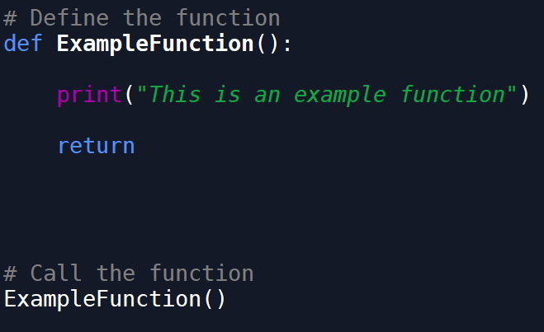
Functions
Functions

Slide 80
Functions
Functions
Defining the function:
def <function_name>(parameter_list):
<body of function>
return <optional_return_val>
Calling the function:
<function_name>(<argument_list>)

Slide 81
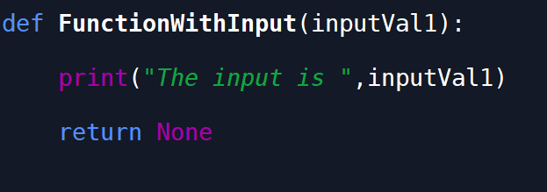
Functions
Functions
Functions can have inputs

Slide 82
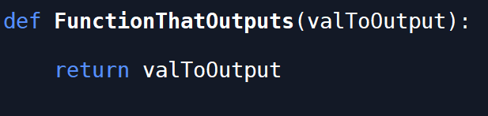
Functions
Functions
Functions can have outputs

Slide 83
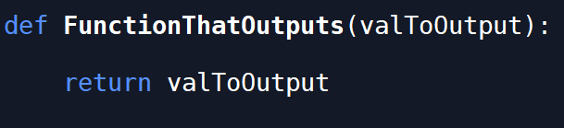
Functions
Functions
Functions do not have to have code in them
Can be used as a place holder for future code
Helps plan out what needs done

Slide 84
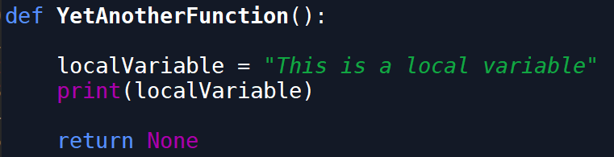
Functions
Functions
Allow local, temporary variables to be utilized
Deleted once the function has been used

Slide 85
Functions
Scope
Tells what variables and objects are available in what section of code
In general:
Global scope
Local scope
More later

Slide 86
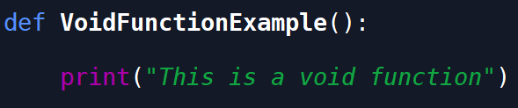
Functions
Functions
Void Functions
Returns nothing (None in python)
Function still does something

Slide 87
Functions
Functions
Example function ./Instructional Material/Class Examples/Example Functions.py

Slide 88
Functions
Functions
Is there a way to utilize this one piece of code without writing it over and over again?

Slide 89
Functions
Functions
Without functions, lots of duplicate code
In-class example: ./Class Examples/Function Examples - Get Largest Value Without Function.py

Slide 90
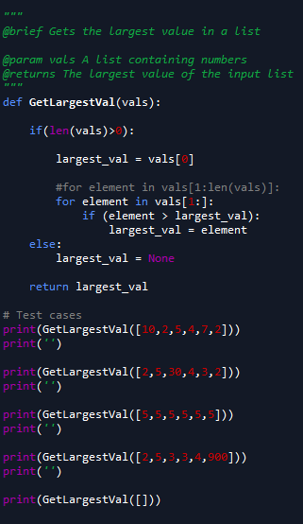
Functions
Functions

Slide 91
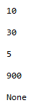
Functions
Functions

Slide 92
Functions
Functions
Is there a way I can write this piece of code just once, so I can change the code in one place versus a million?

Slide 93
Functions
Functions
Is there a way I can categorize certain sections of code, so that I can understand the high level ideas of sections of code without having to understand all the little details?

Slide 94
Functions
Functions
Guess what the code does on the next slide (Google is allowed)

Slide 95
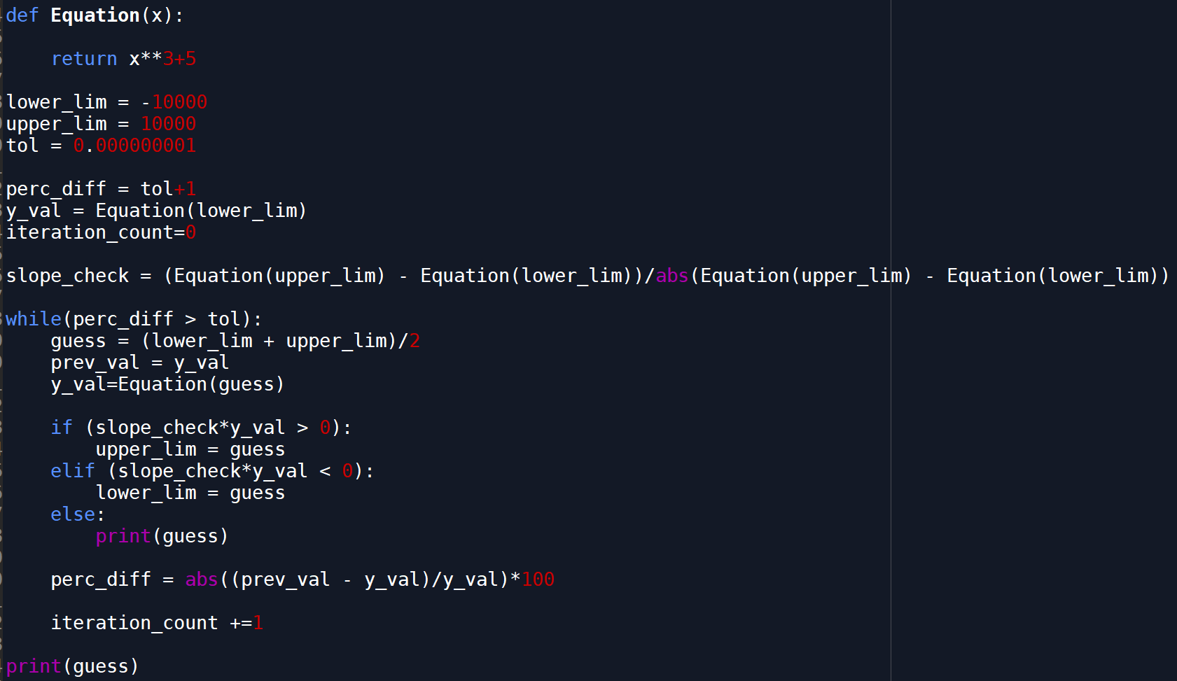
Functions
Functions

Slide 96
Functions
Functions
How about now?

Slide 97
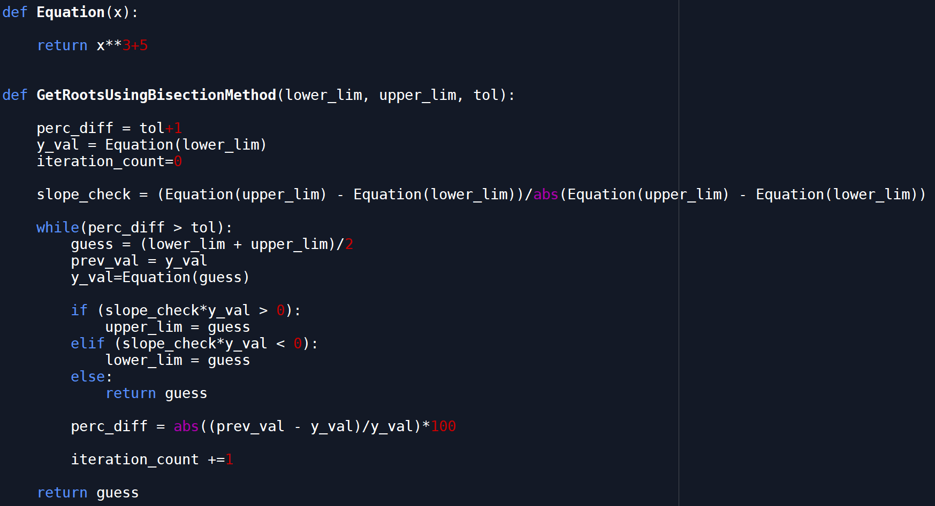
Functions
Functions

Slide 98
Functions
Functions
Review of function code thus far can be found in the files at ./Class Examples/Example Functions.py

Slide 99
Functions
Functions Class Exercises
Create a function that will return a number
Create a function with two inputs
Create a function with two string inputs, that returns the two strings combined together separated by a space.
I.e. func(“string_1”,”string_2”) == “string_1 string_2”

Slide 100
Functions
Functions Class Exercises
Create a function with an input of a list of integers. The output is the same list, with each value squared. The function must contain a loop or a list comprehension.

Slide 101
Working with Files
Working with Files
Problem:
I know how to write code, and I can input my own data into a script, but I usually have data stored in some file that I need to work with.
How do I access data from files?
What files can Python read?

Slide 102
Working with Files
Working with Files
How do I access data from files?
open Command
open(filepath,mode)
with open(filepath,mode) as file:

Slide 103
Working with Files
Working with Files
File Access Modes
Character | Meaning
'r' | open for reading (default)
'w' | open for writing, truncating the file first
'x' | open for exclusive creation, failing if the file already exists
'a' | open for writing, appending to the end of the file if it exists
'b' | binary mode
't' | text mode (default)
'+' | open for updating (reading and writing)

Slide 104
Working with Files
Working with Files
Examples at ./Instructional Material/Class Examples/File Access Examples/File Access Examples.py

Slide 105
Working with Files
Working with Files
What files can Python read?

Slide 106
Working with Dates
Working with Dates
Problem: I can now get data from files, or am getting data from a database system, but all the dates are stored as strings. This makes it hard to add or subtract days, months, and/or years.
How can I manipulate dates?

Slide 107
Working with Dates
Datetime Library
Functions
Datetime.datetime.Strptime()
Datetime.datetime.Strftime()
Datetime.timedelta
How data is stored
Getting specific parts of a datetime
Hours, days, etc
Limitations: can only use periods up to a month

Slide 108
Working with Dates
DateUtil Library
Compatible with datetime library
Same objects
Dateutil.relativedelta.relativedelta()
Periods up to a year

Slide 109
Working with Dates
Datetime Library Side Notes
See example script “Datetime Tutorial.py

Slide 110
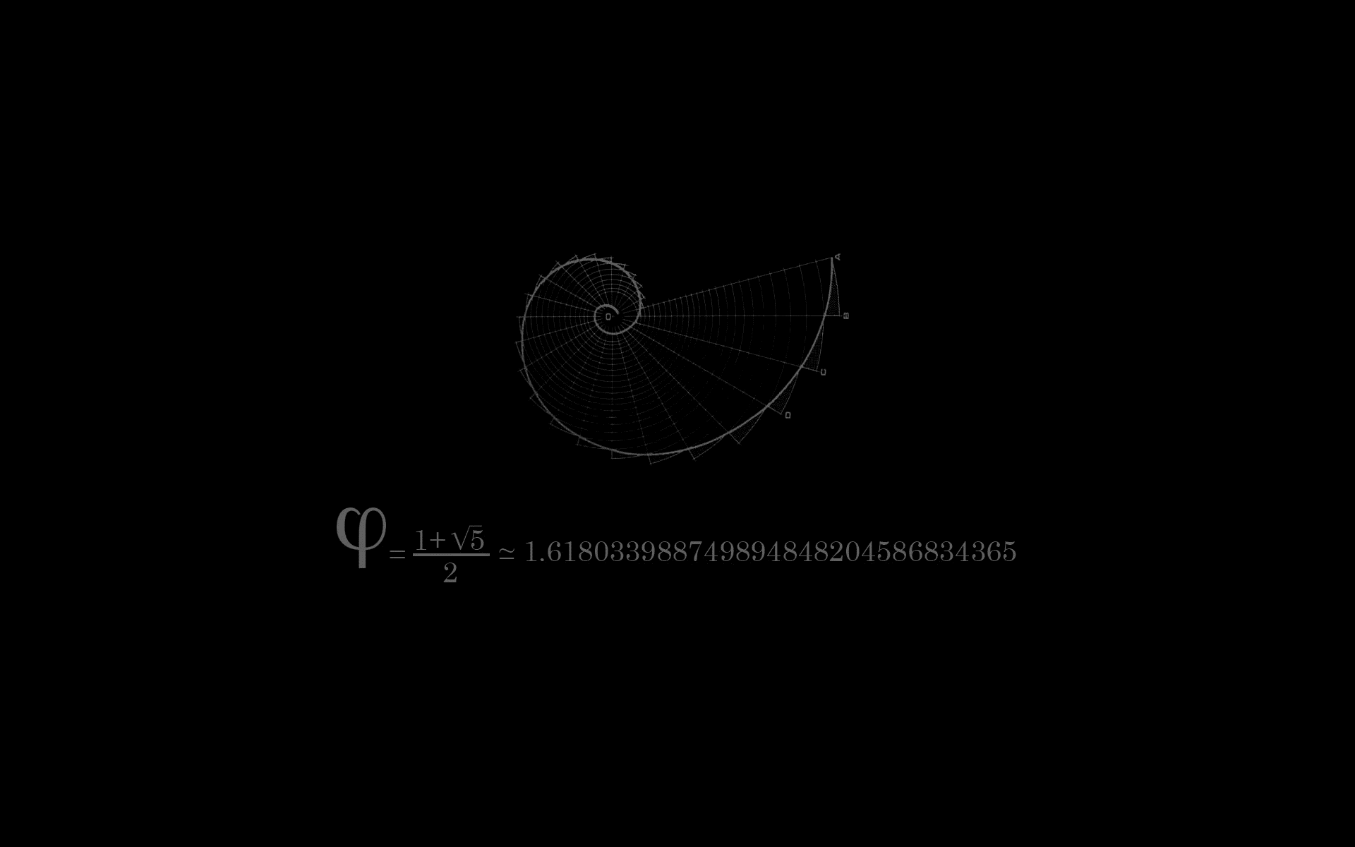
In-Class Exercises
Loop Exercises

Slide 111
In-Class Exercises
Function Exercises

Slide 112
In-Class Exercises
File Manipulation Exercises

Slide 113
In-Class Exercises
Conditional Exercises

Slide 114
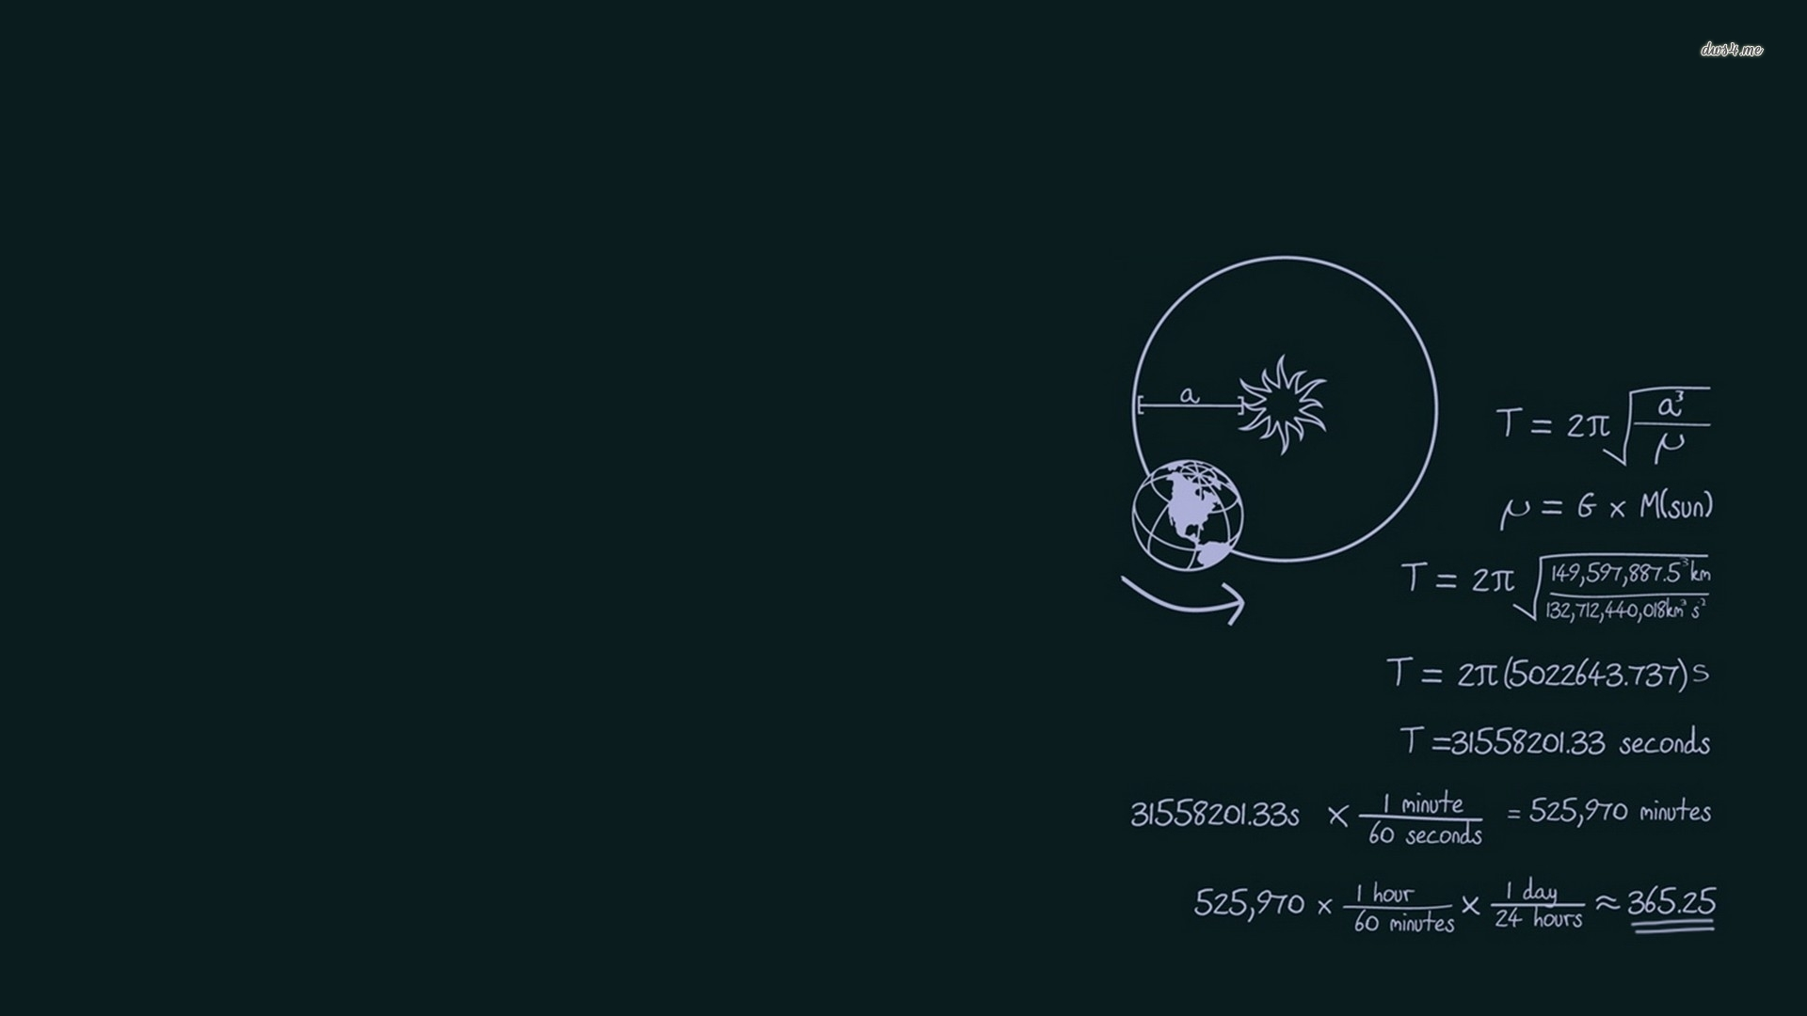
Mini Project
Given a list of part numbers to search and a list of part numbers to find, both in files, find how many

Slide 115
Extending Python
More Types
Furthering the Collective
Improved Logic and Error Handling
List Comprehensions
Lambda Expressions
Working with Files
Classes in Python
Keyword Arguments
GUI’s
Creating Executables

Slide 116

Extending Python
More types
Complex Numbers
complex(real,complex)
z=complex(3,4)
j as complex variable name
Z=3+4j = complex(3,4)
conjugate()
Complex conjugate
z.conjugate() = 3-4j

Slide 117
Extending Python
Furthering the Collective
Methods for lists, tuples, and dictionaries
min(x)
Get the element that has the minimum value in x
max(x)
Get element that has the maximum value in x
len(x)
Number of elements in x
Can also get the number of characters in a string

Slide 118
Extending Python
Furthering the Collective
Methods for lists
example_list.pop()
Remove and output the last element in the list
example_list.append(val)
Add val as a new element to the end of example_list
example_list.reverse()
Invert the relative location of each element in example list
See more in the docs
https://docs.python.org/3/library/stdtypes.html

Slide 119
Extending Python
Furthering the Collective
Slice notation to access elements
a[start:end] # items start through end-1
a[start:] # items start through the rest of the array
a[:end] # items from the beginning through end-1
a[:] # a copy of the whole array

Slide 120
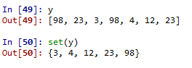
Extending Python
Furthering the Collective
set
Set with {}
Creates distinct unordered pair
No indexing available
Removes any duplicates input into the set

Slide 121
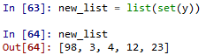
Extending Python
Furthering the Collective
set
Can convert to list to use elements
Notice change in order from the first list once the set is converted back to a list

Slide 122
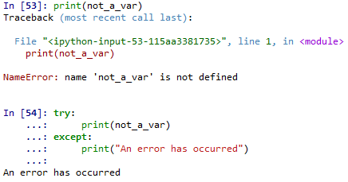
Extending Python
Improved Logic and Error Handling
Try-Except
Error handling

Slide 123
Extending Python
Improved Logic and Error Handling
Try-Except
Syntax
try:
<code statements to try>
except <error_type_1>:
<code when error type occurs>
except <error_type_2> as err:
<code when error type occurs, aliased as “Err”>
except:
<code that catches all other errors>

Slide 124
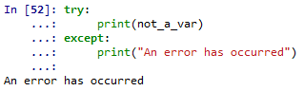
Extending Python
Improved Logic and Error Handling
Try-Except
Can catch all errors without specifying an exception

Slide 125
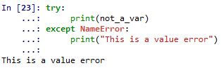
Extending Python
Improved Logic and Error Handling
Try-Except
Can catch specific types of errors by defining the exception

Slide 126
Extending Python
Improved Logic and Error Handling
Exception Types
https://docs.python.org/3/library/exceptions.html
NameError – Undefined variable

Slide 127
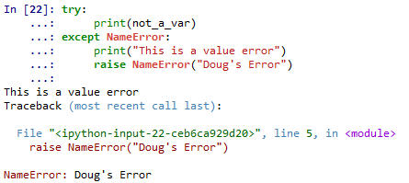
Extending Python
Improved Logic and Error Handling
Naming Errors
raise NameError(<error_name>)

Slide 128
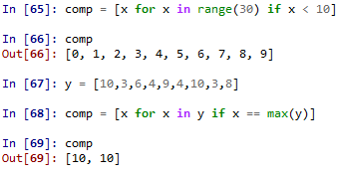
Extending Python
List Comprehensions
A better loop
Combine with conditionals

Slide 129
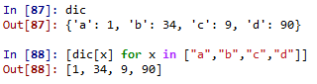
Extending Python
List Comprehensions
Example – Get specific values in a dictionary

Slide 130
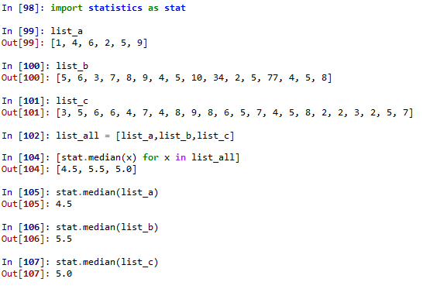
Extending Python
List Comprehensions
Example – get median of a list of lists

Slide 131
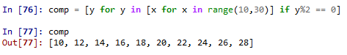
Extending Python
List Comprehensions
Nested list comprehensions
Example – get even numbers between 10 and 30

Slide 132
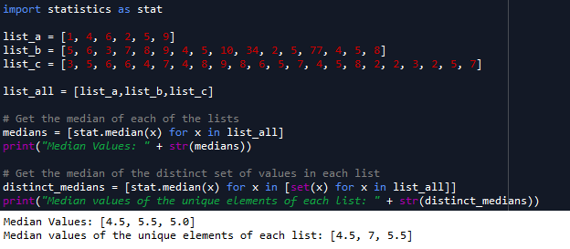
Extending Python
List Comprehensions
Can nest list comprehensions
Example – get medians of sets of values, and medians of the unique set of the same values

Slide 133
Extending Python
Lambda Expressions
Anonymous functions
a.k.a inline function
Very useful in Pandas

Slide 134
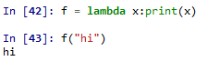
Extending Python
Lambda Expressions
lambda <dummy_var>: <statement using dummy var>

Slide 135
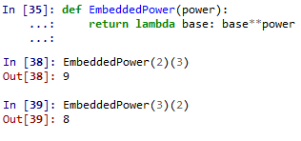
Extending Python
Lambda Expressions
Embedded function

Slide 136
Extending Python
Working with Files
open()

Slide 137

Quiz
Define:
List Comprehensions
Sets
Slice notation
Lambda expressions
List some error handling constructs in Python

Slide 138
Quiz
Objects
Quick definition
What 3 basic items define an object
Are classes needed to program?
Are classes needed to program well?
What are some things classes good for

Slide 139
Quiz Answers
List Comprehensions
Combination of a for loop and possible conditional statements in one statement
Sets
Unique, unordered set of values
Convertible to list if order/editing is needed

Slide 140
Quiz Answers
Slice notation
Allows quick access to sections of collections
Lambda expressions
In-line, anonymous functions aliasable to a variable name
Usable in standard functions
Requires additional argument list

Slide 141
Quiz Answers
List some error handling constructs in Python
Try-Except Statement
Allows attempted code execution
Code in try section will run
If failure occurs, execution immediately breaks to Except section

Slide 142
Quiz Answers
List some error handling constructs in Python
Exceptions
Can create an Except section for each type of exception
Raise
Raises an exception with a custom name

Slide 143
Quiz
Objects
Quick definition
Organizational construct that contains related properties, methods, and hierarchy/inheritance
Ability to control access and reuse (access modifiers)
Allows the creation of user-defined datatypes
Reference types are created from classes
What 3 basic items define an object
Identity
State
Behavior

Slide 144
Quiz
Objects
Are classes needed to program?
No
Are classes needed to program well?
No

Slide 145
Quiz
Objects
What are some things classes good for
Organization
Access control
Code reuse
Breaking up code into easily testable, easily understandable sections
Easy maintenance

Slide 146
Extending Python
Classes in Python
Quick Review of Classes
Note: This quick review is the general case of classes. Python has some idiosyncrasies that will be discussed later

Slide 147
Extending Python
Classes in Python
Quick Review of Classes
ID – Constructor, variable name, memory location(s)
State – Properties/Fields
Behavior - Methods

Slide 148
Extending Python
Classes in Python
Quick Review of Classes
Static – One class only
Example – ‘random’ class in Python
Dynamic/Instance – Objects created for each instance
Any primitive variable (string, int, etc)
Dictionaries
Lists

Slide 149
Extending Python
Classes in Python
Quick Review of Classes
Access
Can set members’ access levels
public
private
protected
internal
Note: This is not enforced in Python—all members are public

Slide 150
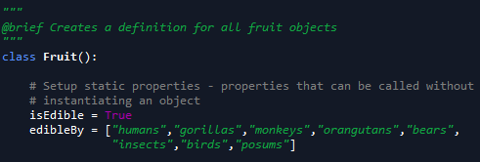
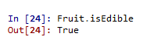
Extending Python
Classes in Python
Static Properties
Callable without creating an object from the class
Defined before the constructor
Similar to how properties defined in C#

Slide 151
Extending Python
Classes in Python
Object Properties
Defined anywhere in a function/constructor
Use the “self” keyword to differentiate from static properties

Slide 152
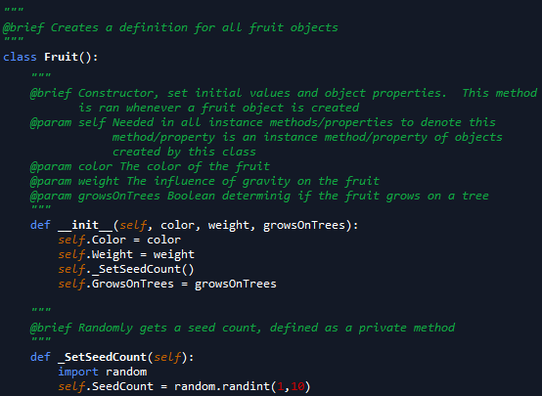
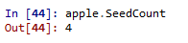
Extending Python
Classes in Python
Object Properties

Slide 153
Extending Python
Classes in Python
Object Properties
Notice scope difference in previous example
“self” keyword indicates object property
Not a local variable of _SetSeedCount(self)
Attempting to access SeedCount without “self” gives error
Why is this?

Slide 154
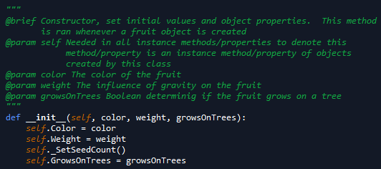
Extending Python
Classes in Python
Constructor
Initialization method
Always has “self” as a parameter
Always “def __init__(self,<list_of_parameters>)”

Slide 155
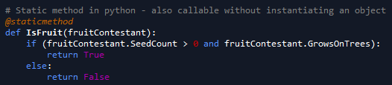
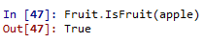
Extending Python
Classes in Python
Methods
All functions other than constructor in the class
Static methods have decorator precursor @staticmethod

Slide 156
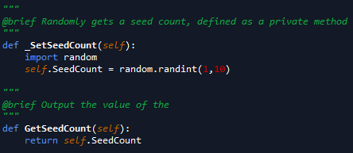
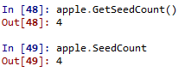
Extending Python
Classes in Python
Methods
Instance methods defined as a normal function
Always has “self” as a parameter

Slide 157

Extending Python
Classes in Python
Methods
Static Method Example

Slide 158


Extending Python
Classes in Python
Inheritance
Ability for one class to use properties and methods of its parent class

Slide 159
Extending Python
Classes in Python
Inheritance
super() used to call parent methods/get parent properties in the child object

Slide 160
Extending Python
Classes in Python
Access Control in Python
Honor system
Private fields, properties, and methods start with an underscore
“_internal_var”
“def _internal_method():”

Slide 161

Extending Python
Classes in Python
Access Control in Python
Notice lack of prevention of using “private” methods

Slide 162
Extending Python
Classes in Python
Abstract Classes
Cannot create types from this class
A class intended only to be inherited from
Will go over more in C# due to ease of understanding code

Slide 163
Extending Python
Classes in Python
Example Day
Code Design
Unified Modeling Language (UML)
Block diagrams of members of classes
Methods
Properties
Fields

Slide 164
Extending Python
Classes in Python
Examples Premade
Helper class
Helper Class for Math
Examples Created In Class
Animal → Mammal → Cat
Food → Meat → Steak

Slide 165
Extending Python
Positional and Keyword Arguments
Defines order of how arguments are passed to functions/methods
Just like passing values in command line languages like PowerShell and bash

Slide 166

Extending Python
Positional and Keyword Arguments
Positional Argument
Arguments passed in the order of the parameters
If order is not maintained, errors will occur

Slide 167
Extending Python
Positional and Keyword Arguments
Keyword Arguments
Argument preceded by an identifier
Must be used with default parameters
Order does not need to match parameter order

Slide 168

Extending Python
Positional and Keyword Arguments
Keyword Arguments
Notice the argument order of the function call

Slide 169

Extending Python
Positional and Keyword Arguments
Can combine both
Positional parameters must occur first

Slide 170

Extending Python
Arbitrary Argument Lists
List of arguments without formal parameters in methods/functions
Denoted by parameter “*<param_name>”
Typically denoted by “*args”
Can use any name, such as “*list_of_stuff”

Slide 171


Extending Python
Keyword Dictionaries
Similar to arbitrary arguments, but parameters are a dictionary
Uses syntax “**<dict_name>”
Typically, named “**kwargs” or “**keywords”

Slide 172
Extending Python
GUI’s
PyQt
Popular C++ GUI ported to Python
TKInter
Gnome
Based on Gnome Linux desktop environment
PyGTK
Based on GTK Linux desktop environment
IronPython
Based on MS .NET platform
Can import DLL’s from other languages
WxPython
We will focus on PyQt

Slide 173
Extending Python
GUI’s
Terminology
Window
A graphical interface with controls
Widgets (a.k.a Controls in C#)
Inputs and outputs
Text box
Input Box
Button

Slide 174
Extending Python
GUI’s
Basics of Program
Class that inherits from base window class
Initialization from base class
Use of show() method on class to make window appear
Create QApplication app
Instantiate object of Window
Exit code execution using app.exec_() or app.exe() (Python version >= 3.x)
See BasicWindow.py for basic example

Slide 175
Extending Python
GUI’s
Basics of Program
Necessary Imports
PyQt5.QtWidgets.QWidget
PyQt5.QtWidgets.QApplication

Slide 176
Extending Python
GUI’s
Basics of Program
QWidget
Base class to inherit Window classes from
QApplication()
Manages GUI application control flow and settings
Initializes necessary objects behind the scenes
There can be only 1 per GUI application
Can have as many windows as possible
Must pass sys.argv, still determining why

Slide 177
Extending Python
GUI’s
Initial Curiosities/Gotchas
The system will return ‘-1’ after a successful run
After each successful run, the kernel must be restarted

Slide 178
Extending Python
GUI’s
Window
Inherit from base QT window ‘Qwidget’
Defaults

Slide 179
Extending Python
GUI’s
Window Properties
Size
Defaults to center of screen at a default size
Can change with ‘self.setGeometry(<left>, <top>, <width>, <height>)’ method
Title
Default title is ‘pythonw’
Can change with ‘self.setWindowTitle(<title>)’ property

Slide 180
Extending Python
GUI’s
Window Text
Two types:
QLabel
Textbox

Slide 181
Extending Python
GUI’s
Window Text using QLabel
Can show text via text and QLabel
Create QLabel
Set text
Format using setStyleSheet
See TextWindow.py for example

Slide 182
Extending Python
GUI’s
Window Text using QLabel
Necessary Imports
PyQt5.QtWidgets.QLabel

Slide 183

Extending Python
GUI’s
Window Text using QLabel
Styling
Box Model, like web languages

Slide 184
Extending Python
GUI’s
Window Text using QLabel
Styling
<QLabel_Var>.move(left, top)
Move the location of the text to the (left, top) position
The left coordinate is measured from the left side, to the right
The top coordinate is measured from the top towards the bottom
<QLabel_Var>.setStyleSheet(<style_string>)
Sets the style in a CSS-like layout

Slide 185
Extending Python
GUI’s
Window Text using QLabel
Example code TextWindowQLabel.py

Slide 186
Extending Python
GUI’s
Window Text using Textboxes
QLineEdit in PyQt
Create QLineEdit object
Set the text using the “setText()” method
Show the QLineEdit object

Slide 187
Extending Python
GUI’s
Window Text using Textboxes
Necessary Imports:
PyQt5.QWidgets.QLineEdit

Slide 188
Extending Python
GUI’s
Window Text using Textboxes
Example code TextWindowQLineEdit.py

Slide 189
Extending Python
GUI’s
Quick note on documentation
Don’t forget to check parent docs for all functions
Example: QLineEdit.move
Function does not exist on QLineEdit page
http://doc.qt.io/qt-5/qlineedit.html
Exists on QWidget page, the parent of QLineEdit
http://doc.qt.io/qt-5/qwidget.html#move-1
TLDR: Check chain of inheritance for missing members

Slide 190
Extending Python
GUI’s
How do I know the chain of inheritance?
Check Docs
Can tell from imports
Example:
QLabel and QLineEdit are children of PyQt5.QWidgets

Slide 191
Extending Python
GUI’s
Window Images
Can show images via pixel maps
Create QLabel
Create QPixmap of image
Set the Pixmap property of the QLabel
See ImageWindow.py for example

Slide 192
Extending Python
GUI’s
Window Images
Necessary Imports:
PyQt5.QtWidgets.QLabel
PyQt5.QtGui.QIcon
PyQt5.QtGui.QPixmap

Slide 193
Extending Python
GUI’s
Window Images
QLabel
Class provider for images or text:
Plain text
Rich text
Pixmap
Movie
Number
Nothing
Cannot be used for direct interaction

Slide 194
Extending Python
GUI’s
Window Images
QPixmap
Used to show images on screen
Other objects used for pixel manipulation and other functionality
See https://doc.qt.io/qt-5/qpixmap.html for more

Slide 195
Extending Python
GUI’s
Button
Necessary Imports
PyQt5.QtWidgets.QPushButton
PyQt5.QtWidgets.QVBoxLayout

Slide 196
Extending Python
GUI’s
Button
Create the button
self.button = QPushButton(<button_text>, self)
Create optional items
Tool tip: self.button.setToolTip(<tool_tip_text>)
Create event handler for button click
Can be any method
Link event handler (a.k.a. slot) to the connect signal
self.button.clicked.connect(self.<method_name>)

Slide 197
Extending Python
GUI’s
Button
Fix layout automatically with QBoxLayout
Default position is top left
QVLayout will auto-align button object(s) vertically
layout = QVBoxLayout(self)
layout.addWidget(self.<button_ojbect>)

Slide 198
Extending Python
GUI’s
Signals and Slots
Signal calls a method (acts as event caller)
Use like an object: sig = pyqtSignal()
Wire to an action and emit:
self.sig.connect(self.<method>)
Self.sig.emit()
Slot handles the signal (acts as event action)
Define slot method with @pyqtSlot() decorator
@pyqtSlot()
def slot():
Do_stuff
For our code, the signal and slot are automatically created and don’t need specifically created
See http://pyqt.sourceforge.net/Docs/PyQt5/signals_slots.html for more

Slide 199
Extending Python
GUI’s
Other Widgets
QCheckBox
Check box
QSlider
Slide bar with handle
QProgressBar
Bar that fills in to show progress
QCalendarWidget
Monthly calendar

Slide 200
Extending Python
GUI’s
Other Widgets
QLineEdit
Box that allows the entering and editing of text
Copy and paste operations allowed
QSplitter
GUI control of child widgets
QComboBox
Menu that drops down, with options a user can select

Slide 201
Extending Python
GUI’s
Further Learning
http://zetcode.com/gui/pyqt5/
https://pythonspot.com/pyqt5/
API References
http://pyqt.sourceforge.net/Docs/PyQt5/
http://doc.qt.io/qt-5/index.html

Slide 202
Extending Python
GUI’s
In-Class Project – War Card Game
UML Class Layout
Design Layout
Paint
Graphic Design Software
Code Design

Slide 203
Extending Python
GUI’s – War Card Game
Code Review
QLabel
QPixmap Image
Text
QPushButton
Button
QLineEdit
Input box for text
QComboBox
Dropdown list of selectable items

Slide 204
Extending Python
Creating Executables

Slide 205

The Pythonic Way
Readability
Tabs vs {}
Explicit Code vs Implicit
*args/**kwargs vs list of each parameter
Built-in mechanism for documentation “”” “””
List Comprehensions
Setting Up Loops
Mathematical Basis

Slide 206
Pandas Data Wrangling
Overview
Series
DataFrames
Grouping
Indexing
Merges
Joins

Slide 207
PyODBC
Overview

Slide 208

PyODBC
PyODBC Data Base Connector

Slide 209
MatPlotLib Visuals
Overview

Slide 210
Scikit-Learn Machine Learning
Overview
Basic Linear Model
Algorithm Types
Tuning

Slide 211
LICENSE
Copyright 2018 Douglas Bowman
Permission is hereby granted, free of charge, to any person obtaining a copy of this software and associated documentation files (the "Software"), to deal in the Software without restriction, including without limitation the rights to use, copy, modify, merge, publish, distribute, sublicense, and/or sell copies of the Software, and to permit persons to whom the Software is furnished to do so, subject to the following conditions:
The above copyright notice and this permission notice shall be included in all copies or substantial portions of the Software.
THE SOFTWARE IS PROVIDED "AS IS", WITHOUT WARRANTY OF ANY KIND, EXPRESS OR IMPLIED, INCLUDING BUT NOT LIMITED TO THE WARRANTIES OF MERCHANTABILITY, FITNESS FOR A PARTICULAR PURPOSE AND NONINFRINGEMENT. IN NO EVENT SHALL THE AUTHORS OR COPYRIGHT HOLDERS BE LIABLE FOR ANY CLAIM, DAMAGES OR OTHER LIABILITY, WHETHER IN AN ACTION OF CONTRACT, TORT OR OTHERWISE, ARISING FROM, OUT OF OR IN CONNECTION WITH THE SOFTWARE OR THE USE OR OTHER DEALINGS IN THE SOFTWARE.

